Slide 1
Algorithmics - Logical Expressions -

Slide 2
Contents
Operators
Decision Control statements
IF
CASE
Loop statements
DO
WHILE
LOOP
Time to Practice

Slide 3
Operators

Slide 4
Logical Expression
A logical expression formulates a condition for operands. The result of a logical expression is a truth value and can therefore be true or false.
We can combine 2 or more logical expressions using Boolean operators. This produces a single output for the expression.
A | B | A AND B | A OR B | NOT A
TRUE | TRUE | TRUE | TRUE | FALSE
TRUE | FALSE | FALSE | TRUE | FALSE
FALSE | TRUE | FALSE | TRUE | TRUE
FALSE | FALSE | FALSE | FALSE | TRUE

Slide 5
Logical expressions
A logical expression consists of comparisons using the operators AND, OR and NOT , as well as the parentheses " (" and ")". The individual operators, parentheses, values and fields must be separated by blanks.
Incorrect:
f1 = f2 AND (f3 = f4).
Correct:
f1 = f2 AND ( f3 = f4 ).

Slide 6
Logical expressions
NOT takes priority over AND, while AND in turn takes priority over OR:
NOT f1 = f2 OR f3 = f4 AND f5 = f6
thus corresponds to
( NOT ( f1 = f2 ) ) OR ( f3 = f4 AND f5 = f6 )
The selection criteria comparisons or checks are processed from left to right. If evaluation of a comparison or check proves part of an expression to be true or false, the remaining comparisons or checks in the expression are not performed.

Slide 7
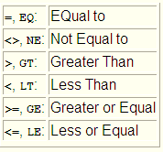
Accepted Operators: Numeric operators

Slide 8
Accepted operators: Character operators
CO (Contains Only)
c1 contains only characters from the string c2.
CN (Contains Not only): "c1 CN c2" is equivalent to " NOT ( c1 CO c2 )".
CA (Contains Any)
c1 contains at least one character from the string c2.
NA (contains Not Any): "c1 NA c2" is equivalent to "NOT ( c1 CA c2 )".
CS (Contains String): c1 contains the character string c2.
NS (contains No String): "c1 NS c2" is equivalent to " NOT ( c1 CS c2 )".

Slide 9
Accepted operators
<f> IS INITIAL compares f with its initial value, which depends on the type involved

Slide 10
Decision Control Statements

Slide 11
IF – basic forms
All IF statements must be concluded in the same processing block by ENDIF.
1. IF logexp. processing1. ENDIF.
2. IF logexp. processing1 ELSE. processing2 ENDIF.
3. IF logexp1. processing1 ELSEIF logexp2. processing2 ELSEIF ... ... ELSE. Processing. ENDIF.

Slide 12
IF - examples
DATA v_result TYPE I. ... IF v_result < 0. WRITE / 'Result less than zero'. ELSEIF v_result = 0. WRITE / 'Result equal zero'. ELSE. WRITE / 'Result greater than zero'. ENDIF.
----------------------------
IF v_result IS INITIAL.
WRITE / 'Result equal zero'.
ENDIF.

Slide 13
CASE
Depending on the current contents of a field, this statement executes one of several alternative processing branches. The field whose contents determine how the subsequent processing is specified after CASE; the individual processing branches are introduced by WHEN, followed by the value to be tested. The entire block is concluded by ENDCASE.
CASE f. WHEN f11 OR f12 ... OR f1n. ... WHEN f21 OR f22 ... OR f2m. ...
WHEN OTHERS. ... ENDCASE.

Slide 14
CASE - example
DATA: v_val TYPE I VALUE 3.
CASE v_val. WHEN 1 OR 2. WRITE ‘Value is 1 or 2’. WHEN 3 OR 4. WRITE ‘Value is 3 or 4’ . WHEN OTHERS.
WRITE ‘Other Value’. ENDCASE.

Slide 15
Loop Statements

Slide 16
DO
Repeats the processing enclosed by the DO and ENDDO statements until the loop is terminated by EXIT, STOP or REJECT.
You can use the CONTINUE statement to end the current loop pass prematurely and continue with the next loop pass.
The system field SY-INDEX counts the number of loop passes, starting from 1. You can nest DO loops. When the processing leaves an inner DO loop, the value of SY-INDEX belonging to the outer DO loop is restored.

Slide 17
DO
Example:
DO. WRITE: / 'SY-INDEX - Begin:’, SY-INDEX. IF SY-INDEX = 10. EXIT. ENDIF. WRITE: 'End:', SY-INDEX. ENDDO.

Slide 18
DO n TIMES
Repeats the processing enclosed by the DO and ENDDO statements n times. If n changes within the loop, this has no effect on loop passes.
Example:
DATA v_count TYPE I. DO 10 TIMES. ADD SY-INDEX TO v_count. ENDDO.

Slide 19
DO: Continue
Terminate current loop – with CONTINUE
DO 4 TIMES.
IF SY-INDEX = 2.
CONTINUE.
ENDIF.
WRITE SY-INDEX.
ENDDO.

Slide 20
DO: Exit
Exiting a loop – with EXIT
DO 4 TIMES.
IF SY-INDEX = 2.
EXIT.
ENDIF.
WRITE SY-INDEX.
ENDDO.

Slide 21
WHILE
Repeats the processing enclosed between the WHILE and ENDWHILE statements as long as the logical expression logexp is true. Checks the condition before each loop pass. If it is no longer true, processing resumes after ENDWHILE . You can use the CONTINUE statement to leave the current loop pass prematurely and skip to the next loop pass.

Slide 22
WHILE - example
DATA: SEARCH_ME TYPE I, MIN TYPE I VALUE 0, MAX TYPE I VALUE 1000, TRIES TYPE I, NUMBER TYPE I.
SEARCH_ME = 23. WHILE NUMBER <> SEARCH_ME. ADD 1 TO TRIES. NUMBER = ( MIN + MAX ) / 2. IF NUMBER > SEARCH_ME. MAX = NUMBER - 1. ELSE. MIN = NUMBER + 1. ENDIF. ENDWHILE. The above code performs a (binary) search for the "unknown" number SEARCH_ME which lies between MIN and MAX. TRIES contains the number of attempts needed to find it.

Slide 23
LOOP
LOOP statement is used to iterate on Internal Tables.
LOOP AT itab INTO struc.
processing_bloc.
ENDLOOP.

Slide 24
LOOP - example
TYPES: BEGIN OF ty_student,
name TYPE c LENGTH 20,
stud_id TYPE n LENGTH 13,
address TYPE string,
END OF ty_student.
DATA: t_student TYPE TABLE OF ty_student.
DATA: s_student TYPE ty_student.
LOOP AT t_student INTO s_student.
WRITE: / s_student-name,
s_student-stud_id,
s_student-address.
ENDLOOP.
OBS: Internal Tables can’t be directly displayed.
Only an Elementary Object can be displayed at time.

Slide 25
Time to Practice

Slide 26
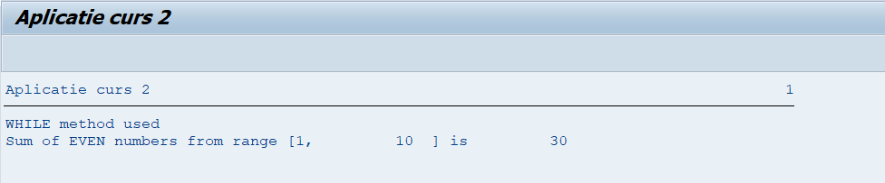
Time to Practice - Exercise
Create a new program ZZuser_C3. Your program should determine sum of the even numbers from range [1, n]
For example, if n=10 => the multiplication will be
2+4+6+8+10 = 30
Solve the requirement using DO statement and WHILE statement. Display the method used.

Slide 27
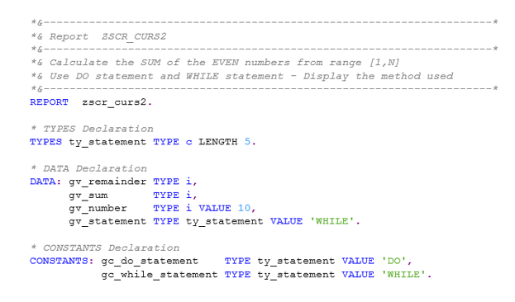
Exercise solution I

Slide 28
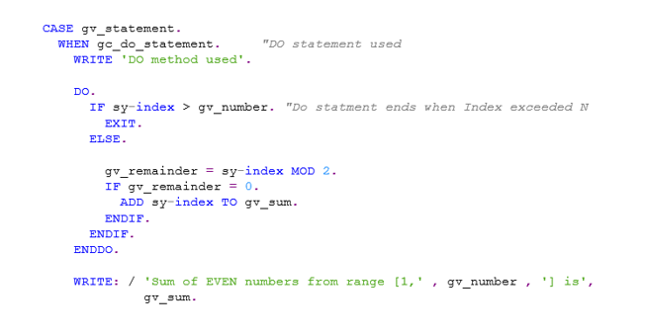
Exercise solution II

Slide 29
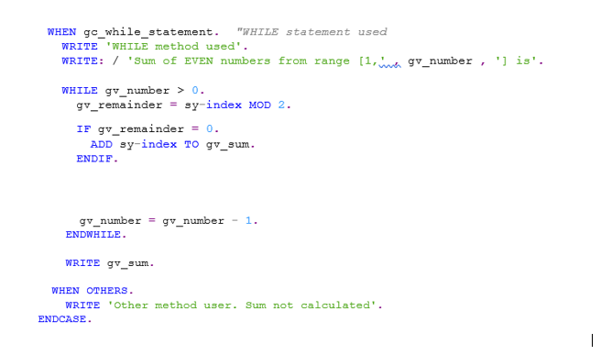
Exercise solution III

Slide 30
Time to Practice: Homework
1. Create a new program ZZuser_C3_ODD ( user is your login user, eg:g001). Your program should determine multiplication of the odd numbers from range [1, n]
For example, if n=8 => the multiplication will be 1*3*5*7 = 105

Slide 31
Time to Practice: Homework
2. Create a program named ZXY_FIBO ( where XY is your user id, for ex gl001). Your program should determine the sum of the first N Fibonacci numbers.
For example: n=8 => the sum will be 1+1+2+3+5+8+13+21 = 54
Read more about Fibonacci series:
https://www.tutorialspoint.com/data_structures_algorithms/fibonacci_series.htm

Slide 32
Time to Practice: Homework
3. Create a program named ZXY_GCD. Your program should determine the greatest common divisor(GCD) of 2 numbers.
For example, the GCD (20, 25) = 5 and GCD (54, 24) = 6

